Slide 1
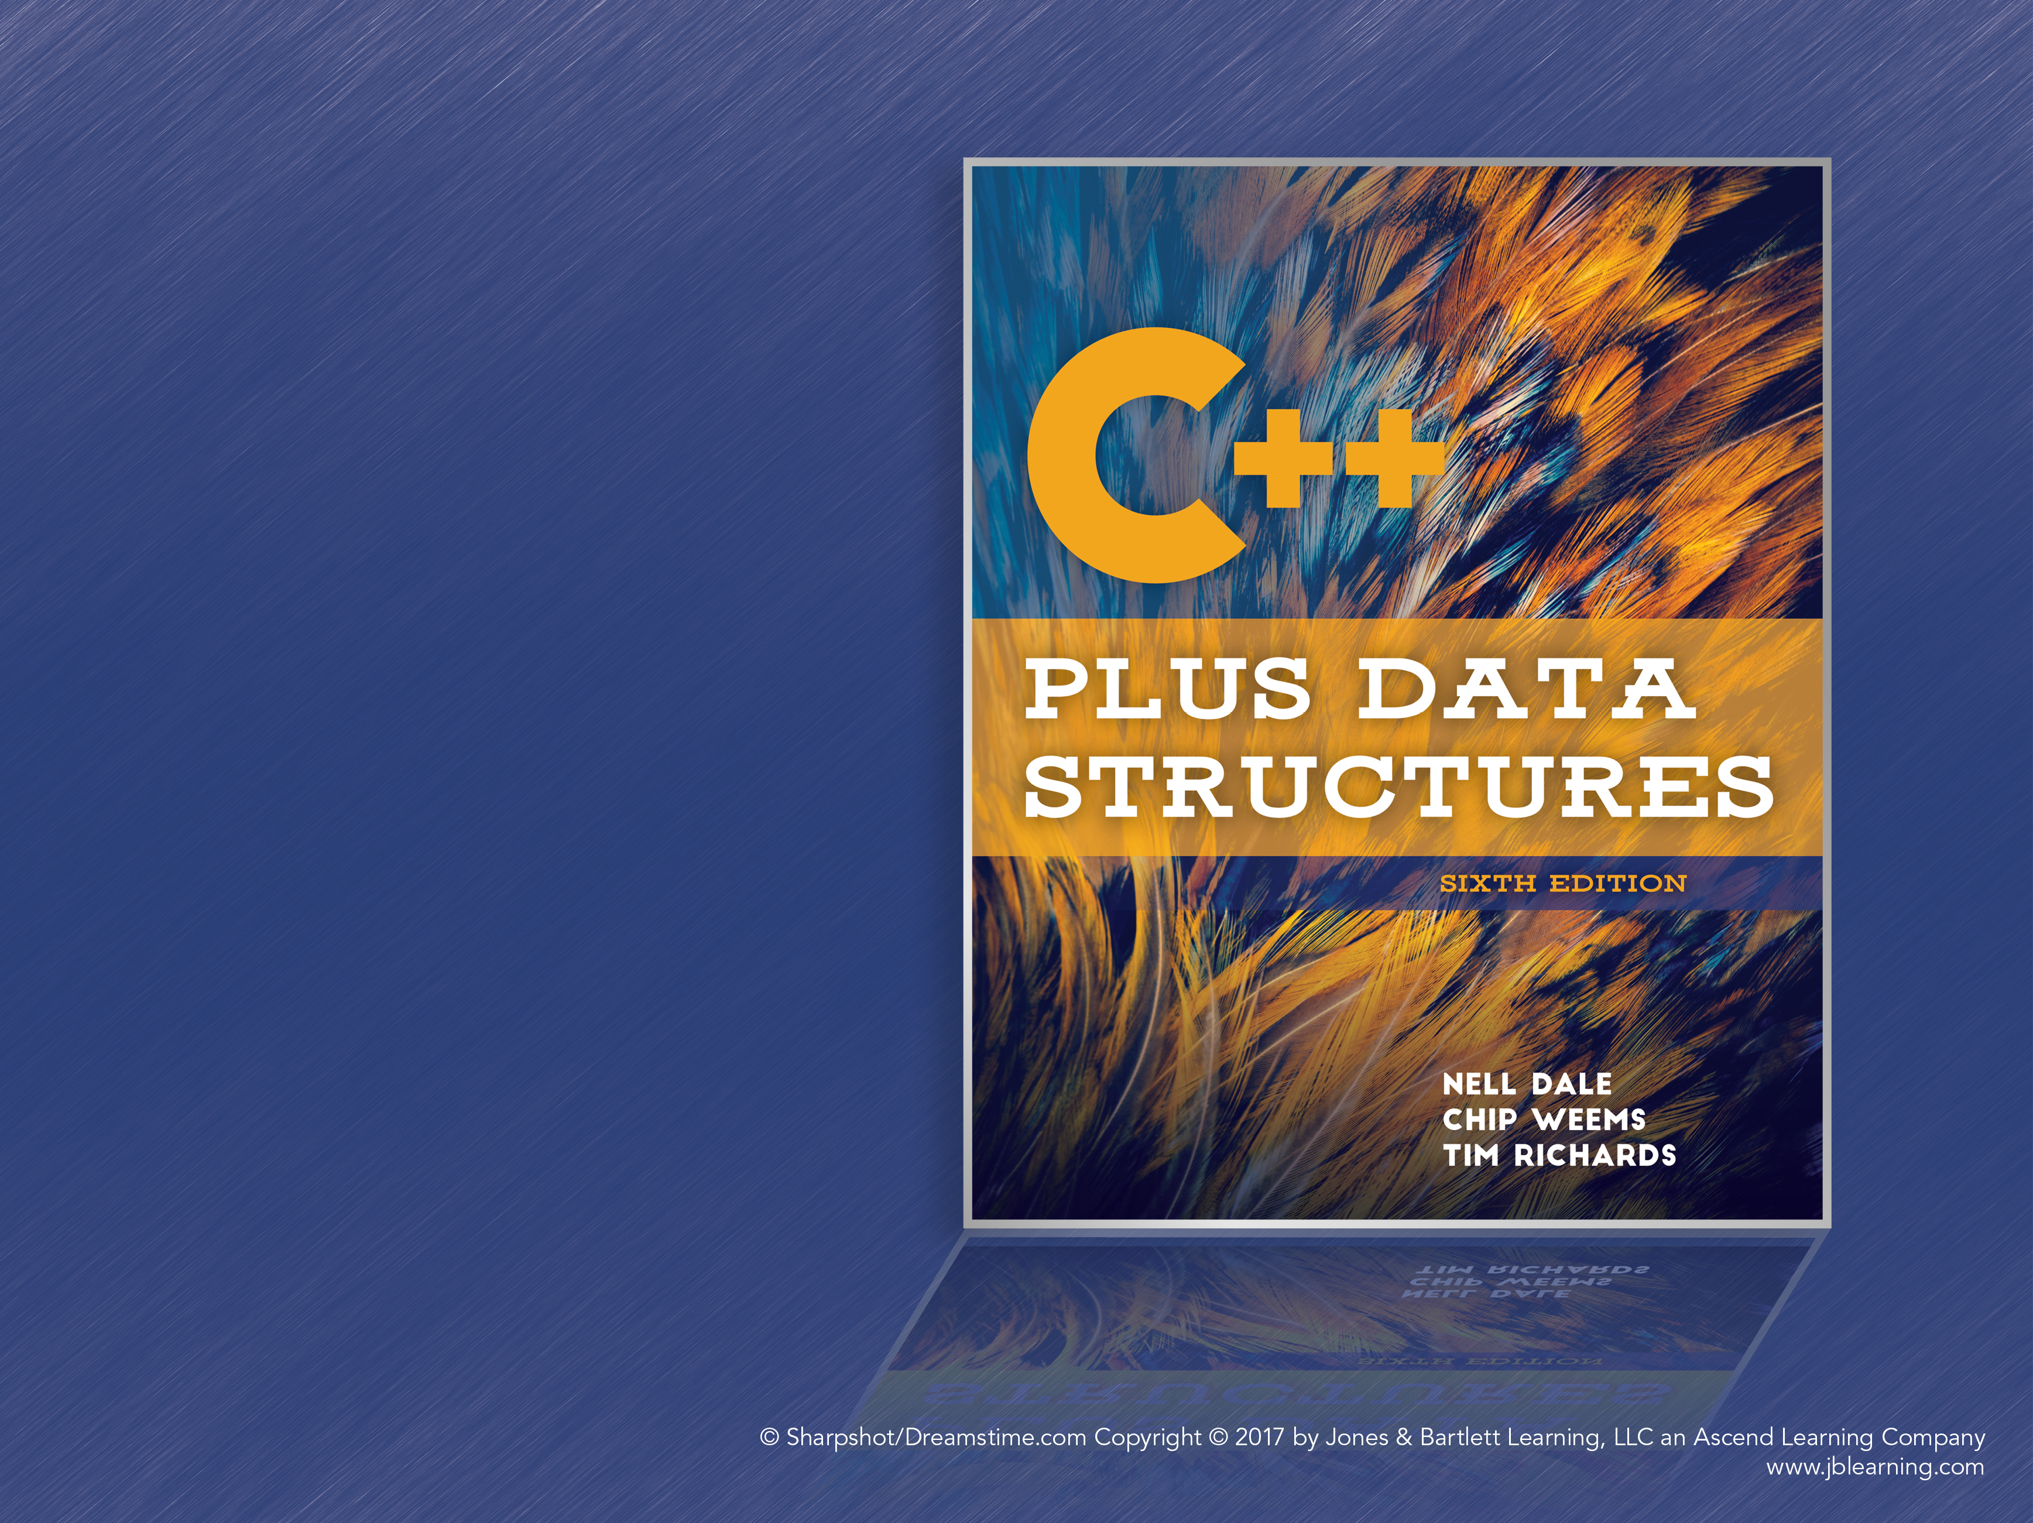
Chapter 12
Sorting

Slide 2
Sorting Revisited
Sorting is a very common and useful operation
Efficient sorting algorithms can have large savings for many applications
The algorithms are evaluated on:
The number of comparisons made
The number of times data is moved
The amount of additional memory used

Slide 3
Sorting Efficiency
Worst Case: The data is in reverse order
Average Case: Random data, may be somewhat sorted already
Best Case: The array is already sorted
Typically, average and worst case performance are similar, if not identical
For many algorithms, the best case is also the same as the other cases

Slide 4
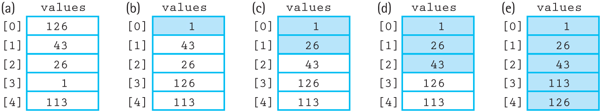
Straight Selection Sort
Set “current” to the first index of the array
Find the smallest value in the array
Swap the smallest value with the value in current
Increment current and repeat steps 2–4 until the end of the array is reached
Figure 12.1 Example of straight selection sort (sorted elements are shaded)

Slide 5
Analyzing Selection Sort
A very simple, easy-to-understand algorithm
N iterations are performed
Iteration I checks N – I items to find the next smallest value
There are N * (N – 1)/2 comparisons total
Therefore, selection sort is O(N²)
Even in the best case, it’s still O(N²)

Slide 6
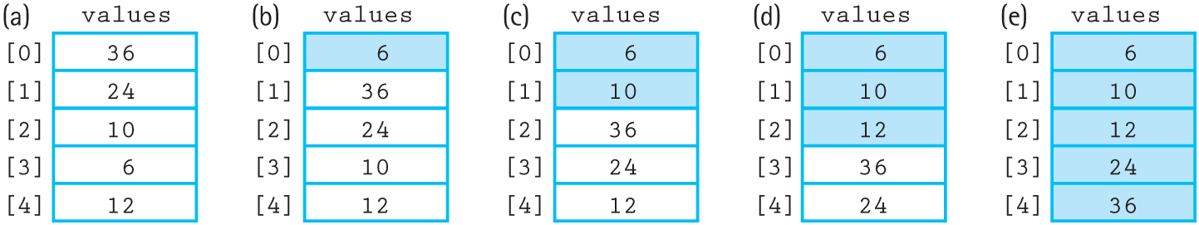
Bubble Sort
Set “current” to the first index of the array
For every index from the end of the list to 1, swap adjacent pairs of elements that are out of order
Increment current and repeat steps 2–3
Stop when current is at the end of the array
Figure 12.3 Example of bubble sort (sorted elements are shaded)

Slide 7
Bubble Sort
The name comes from how smaller elements “bubble up” to the top of the array
The inner loop compares values [index] < values [index-1], and swaps the two values if it evaluates to true
The smallest value is brought to the front of the unsorted portion of the array during iteration

Slide 8
Analyzing Bubble Sort
Takes N-1 iterations, because the last iteration puts two values in order
Each iteration I performs N-I comparisons
Bubble sort is therefore O(N²)
It may perform several swaps per iteration
Is the best case better? An already-sorted array needs only 1 iteration, so the base case is O(N)

Slide 9
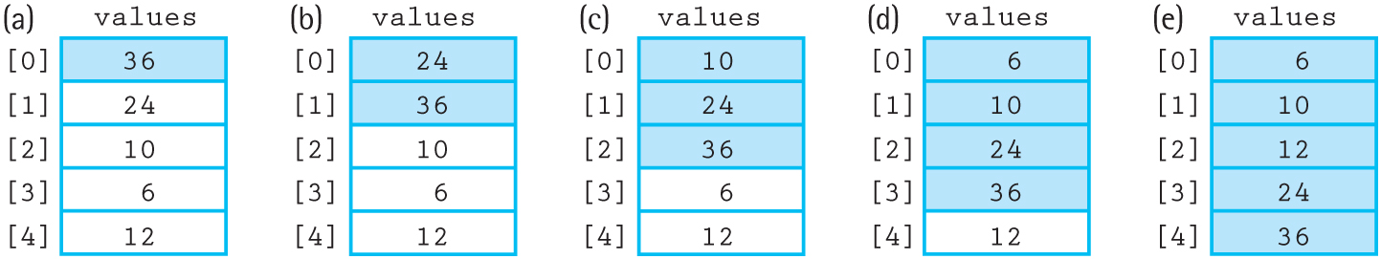
Insertion Sort
Acts like inserting elements into a sorted array, including moving elements down if necessary
Uses swapping (like Bubble Sort) to find the correct position of the next item
Figure 12.5 Example of the insertion sort algorithm

Slide 10
Analyzing Insertion Sort
O(N²), like the previous sorts
Best Case: O(N), since only one comparison is needed and no data is moved
O(N²) is not good enough when sorting large sets of data!

Slide 11
O(N log₂N) Sorts
Sorting a whole array is O(N²) with those sorts
Splitting the array in half, sorting it, and then merging the two arrays is (N/2)² + (N/2)²
This “divide-and-conquer” approach can then be applied to each half, giving O(N log₂N) sort

Slide 12
Merge Sort
Split the array in half
Recursively MergeSort the two halves
Merge the two halves
Base Case: Arrays of <2 elements are already sorted

Slide 13
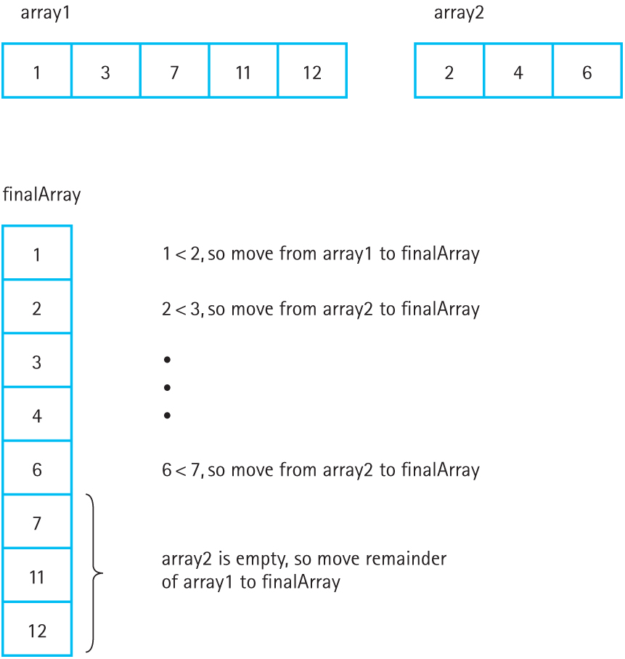
Merging
Figure 12.8 Strategy for merging two sorted arrays

Slide 14
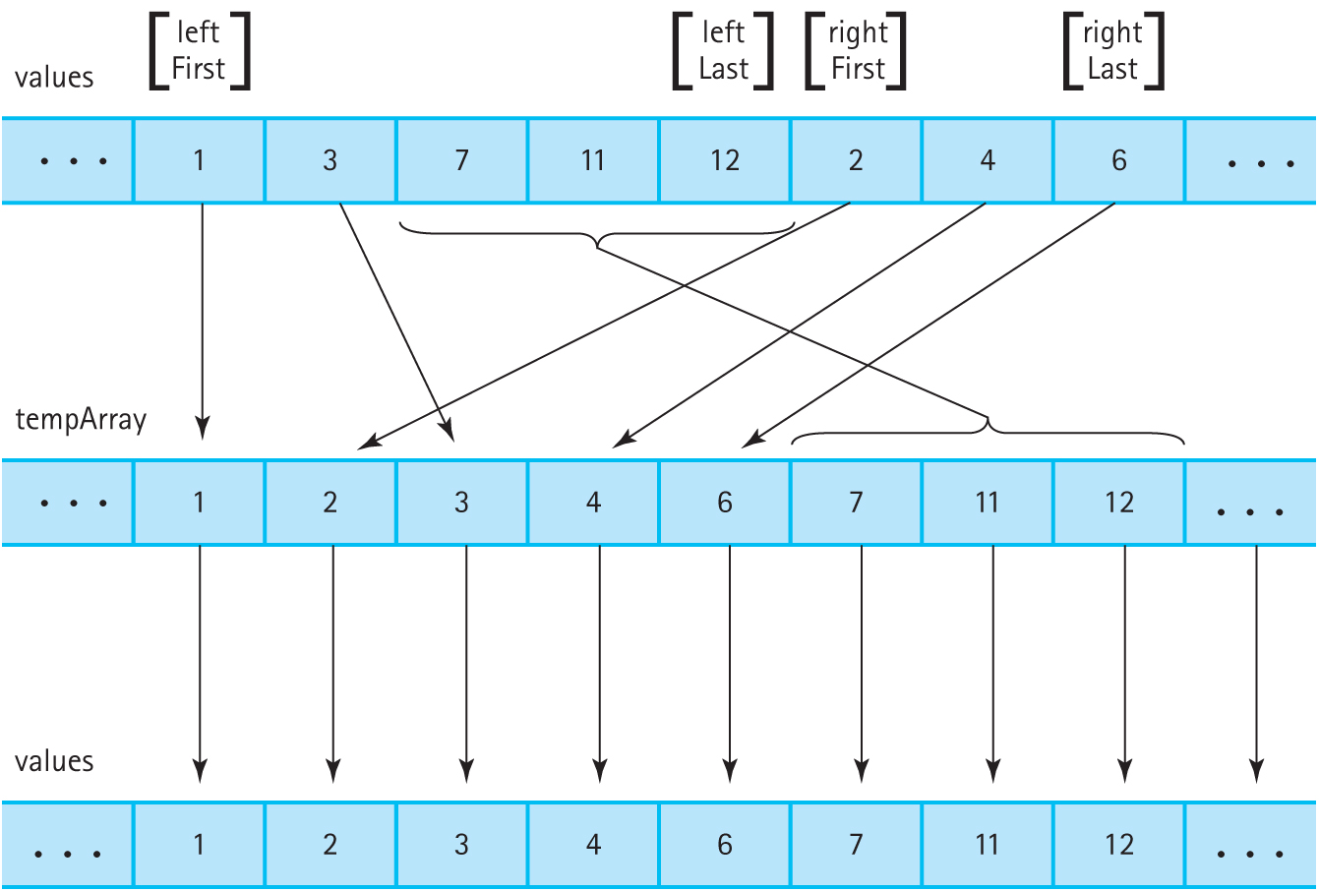
Merging (cont.)
Figure 12.10 Merging sorted halves

Slide 15
Merging Two Arrays
Simultaneously walk through both arrays
If itemA < itemB, copy itemA into the temp array and get the next item from A
If itemB < itemA, copy itemB into the temp array and get the next item from B
Stop when one of the arrays is empty; copy any remaining elements from the other array
Copy the temp array into the original array

Slide 16
Analyzing Merge Sort
The array is split into smaller and smaller arrays until it is finally split into 1- or 0-element arrays
Merging all of these 1-element arrays into 2-element arrays is O(N)
This O(N) merge repeats for each split, which happens log₂N times for O(N log₂N) total
However, merge sort requires O(N) additional memory to perform the merge

Slide 17
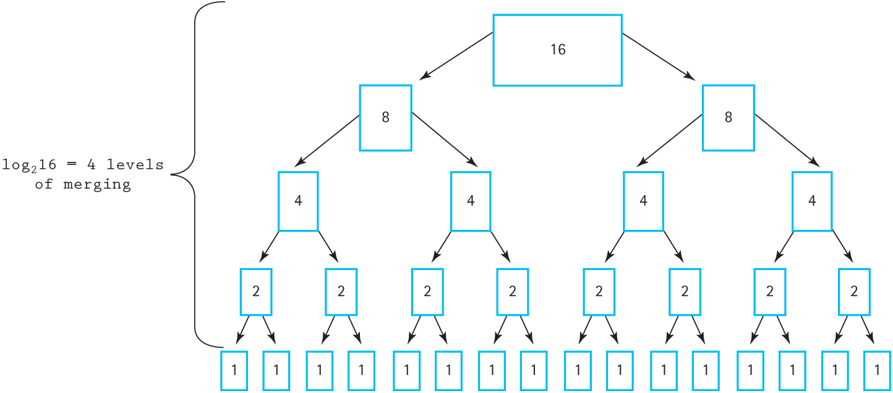
Merging Levels
Figure 12.11 Analysis of the function MergeSort with N = 16

Slide 18
Quick Sort
Choose a value from the array
Use this value to split the array into:
All the values that are less than or equal to the split
All the values that are greater than the split
Recursively quick sort the two subarrays
Originally saw this algorithm in Chapter 7

Slide 19
Analyzing Quick Sort
If the arrays are evenly split, log₂N splits are used and the algorithm is O(N log₂N)
If the array is not split evenly, the algorithm approaches O(N²)
Quick Sort may be inefficient if the data is already mostly sorted
O(log₂N) to O(N) additional memory needed, depending on the splits

Slide 20
Heap Sort
Turns the array into a heap, then places the root at the last unsorted slot of the array until the heap is depleted
Uses heap operations (ReheapDown) to find the next largest element in the heap
Originally seen in Chapter 9

Slide 21
Analyzing Heap Sort
The overhead for building the heap is significant, O(N), and thus heap sort should be avoided for small arrays
ReheapDown is O(log₂N) and is called N times
The overall performance is O(N log₂N)
The initial order of the elements doesn’t matter
No additional space is needed

Slide 22
Other Considerations
Efficiency is not the only thing to consider when choosing which sorting algorithm to use
Big-O ignores constants and other factors, and in some situations O(N²) may grow slower than O(N log₂N)
Note: O(N log₂N) is the theoretical limit for sorting; it can’t get better than that!
But maybe we can improve the coefficients

Slide 23
When N Is Small
O(N²) sorts often have low overhead and few actions besides comparison
O(N log₂N) sorts usually have more overhead and more actions, such as merging
When N is small enough, an O(N²) sort might be faster than an O(N log₂N) sort

Slide 24
Eliminating Calls to Functions
Every function call adds some overhead
But replacing each function call with the body of the function makes code less clear
The inline keyword suggests to the compiler to replace a function call with the function body, giving the best of both worlds
This is useful for functions like Swap that are short and used frequently

Slide 25
Programmer Time
Someone has to take the time to design, implement, and test the sorting algorithms
More complex algorithms are more likely to have errors
Fortunately, we can often rely on standard libraries and packages that have highly optimized and well-debugged implementations

Slide 26
Space Considerations
MergeSort requires an additional N memory
Depending on the implementation and the data, QuickSort may use O(N) memory
HeapSort is more algorithmically complex but uses no additional memory
Consider the memory constraints of the system and the size of the input when choosing

Slide 27
Keys and Stability
A record may contain multiple keys, such as a student’s name, ID number, and major
Some of these keys may not be unique
What if we want a list sorted by major, but have alphabetical order of names within each major?
Sort twice, first by name and then by major
This only works if the sort is stable

Slide 28
Stable Sorting Algorithms
A stable sort is a sorting algorithm that preserves the order of duplicate keys
Heap sort is the only algorithm so far that is inherently unstable
Some algorithms may be unstable depending on their implementation

Slide 29
Stable Sort Example
Start with a list of students:
(ID, Major, Last name)
(01, CHM, Davis)
(02, CSC, Fernandez)
(03, CHM, Patil)
(04, CSC, Albaf)
(05, BIO, Hart)
Goal: sorted alphabetically within majors

Slide 30
Stable Sort Example (cont.)
Sort by Last Name:
(04, CSC, Albaf)
(01, CHM, Davis)
(02, CSC, Fernandez)
(05, BIO, Hart)
(03, CHM, Patil)

Slide 31
Stable Sort Example (cont.)
Sort by Major:
(05, BIO, Hart)
(01, CHM, Davis)
(03, CHM, Patil)
(04, CSC, Albaf)
(02, CSC, Fernandez)

Slide 32
Stable Sort Example (cont.)
An unstable sort would have come up with a different result, such as:
(05, BIO, Hart)
(03, CHM, Patil)
(01, CHM, Davis)
(04, CSC, Albaf)
(02, CSC, Fernandez)
The majors are correct, but last names aren’t

Slide 33
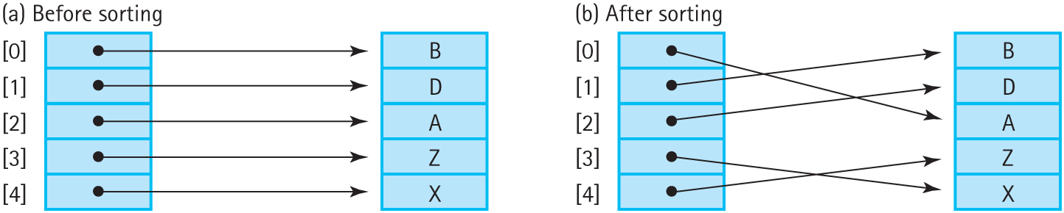
Sorting with Pointers
Moving around large objects is inefficient
Instead, have an array of pointers to those large objects, and have the sort move the pointers
The objects don’t move but can still be accessed in sorted order
Figure 12.12 Sorting arrays with pointers (a) Before sorting (b) After sorting

Slide 34
Caching
Not all computer memory is equal, even though we like to pretend it is
It takes as much time to access a memory cell as for the computer to execute 100 instructions
The processor uses a cache, a small store of very fast memory, to access a small amount of memory quickly

Slide 35
Caching (cont.)
The cache can store a very limited amount of data and code
For example, it may store only a few adjacent list elements, and accessing other list elements requires fetching those elements from memory
An algorithm that makes good use of the cache will be faster than other algorithms that don’t

Slide 36
Sorting Algorithms and Caching
Bubble Sort has predictable memory access patterns, and only compares adjacent elements, which complements the cache’s behavior
Selection Sort must search the whole list for the next smallest element, which will not work well with the cache
An array of pointers to objects scattered throughout memory defeats the cache, since there’s no way to predict the next access

Slide 37
Radix Sort
Radix sort is not a comparison sort; it does not sort by comparing items against each other
The sort considers each position in the key and groups keys by their radix
Radix: The number of possibilities for each position; the digits in a number system
The lowercase letters have a radix of 26
The base-10 digits have a radix of 10

Slide 38
Radix Sort Algorithm
Consider sorting three-digit positive integers
We have 10 queues, one for each digit (0–9)
All the items with a 0 in the ones position are inserted into queue[0], etc.
Once all numbers have been sorted into the queues, collect the values from the queues
Repeat these steps with the tens and hundreds positions

Slide 39
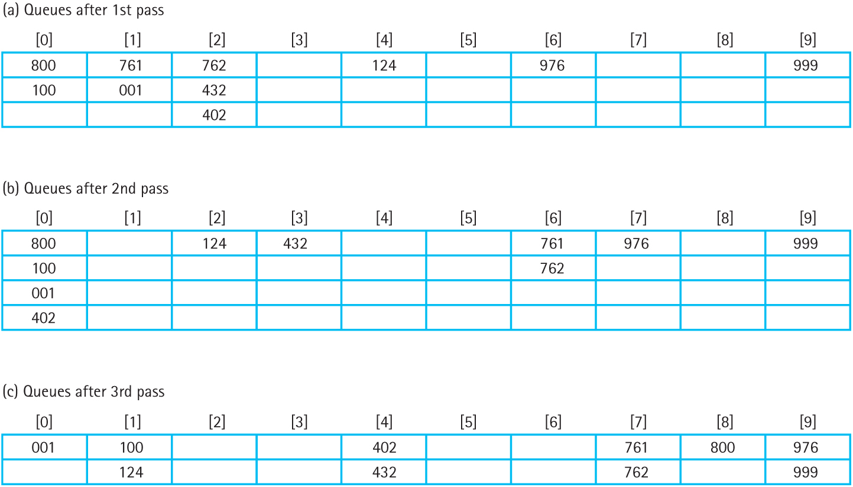
Radix Sort Example
Figure 12.14 Queues after each pass (a) Queues after 1st pass (b) Queues after
2nd pass (c) Queues after 3rd pass

Slide 40
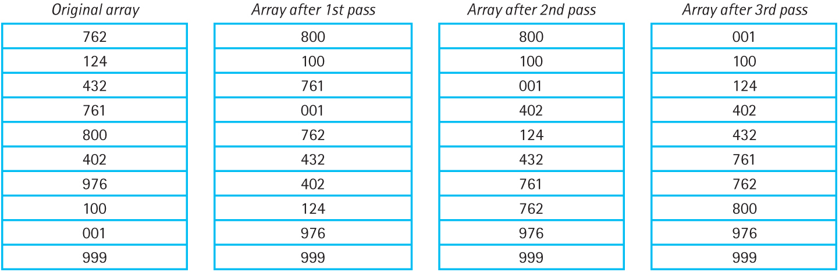
Radix Sort Examples
Figure 12.13 Array after each pass

Slide 41
Radix Sort’s ItemType
Radix Sort must be able to extract a number for each position in the key
This varies between types and is handled by the client code by changing ItemType
Radix Sort needs to know the length of the keys and the radix

Slide 42
Analyzing Radix Sort
Each item (N) is processed once for each position in the key (P)
Radix sort is therefore O(N*P), but since P is likely small relative to N, it’s simply O(N)
Extra memory is needed for the queues
No extra memory is needed if linked lists and linked queues are used; values can be moved from list to queue by changing the pointers

Slide 43
Parallel Merge Sort
Sometimes O(N log₂N) just isn’t enough
Parallel processing performs multiple operations simultaneously, unlike the usual serial (or sequential) processing
Merge sort divides the work into independent parts, which makes it an ideal candidate for splitting among several threads

Slide 44
A Thread for Every Merge
For the first attempt at parallelizing Merge Sort, create a new thread for every recursive call
Each parent thread waits for the two child threads it spawns to finish, then merges the now-sorted arrays
This approach causes incredible slowdowns and will crash the program on large inputs
Each thread has a lot of overhead

Slide 45
Chunks
At a certain array size, threads cost more than they could possible save
When the array is larger than a particular size, spawn new threads; otherwise use regular sequential merge sort
The chunk size is how large arrays must be in order to create more threads
This is passed as a parameter to Merge Sort

Slide 46
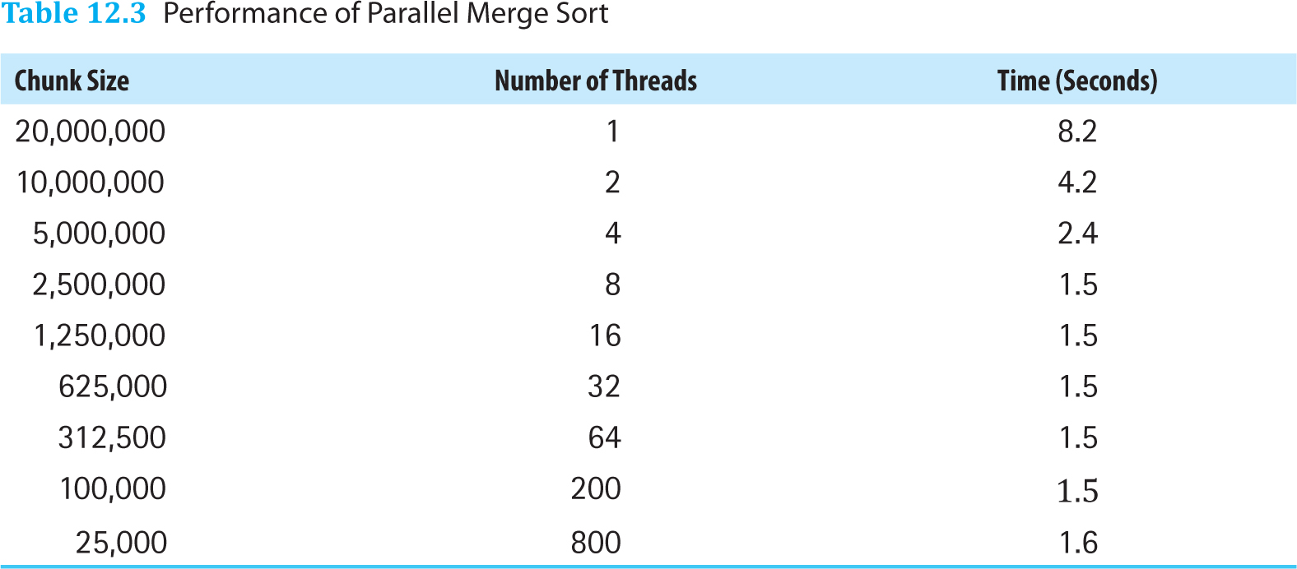
Different Chunk Sizes
Table 12.3 Performance of Parallel Merge Sort
Note that the results are machine dependent. This is a quad-core machine, which can handle at most eight threads at once

Slide 47
Parallel Gains
From the table, spawning eight threads greatly increased performance
But shouldn’t the execution time be 1/8th of the time for a single thread?
No, because merging the arrays is still serial

Slide 48
Parallel Merging
Could merging the arrays be made parallel?
We could try splitting the arrays similar to how quick sort does, by finding a split point and having each thread merge all the values below or above the split value
But, like quick sort, this could cause very uneven splits and be even more inefficient
Parallel merging is very complex with little gain

Slide 49
Avoiding Parallel Access
Merge Sort works well in parallel because each divided part is independent
None of the threads access parts of the array that another thread is using
This kind of interaction can lead to incorrect and unpredictable results

Slide 50
Is Parallelism Worth It?
Parallel merge sort, in this example, was 5.5 times faster than sequential merge sort
Larger data sets and faster, more parallel-capable machines will have even better gains
But parallel computing has complex code and complex bugs
Overall, parallelism is worth it, if it is implemented correctly

